Slide 1
Fandango movie rating discrepancy analysis
CAPSTONE PROJECT
Presented By:
1. K Dhanush Kumar-8144-Sudharsan Engineering College-EEE

Slide 2
OUTLINE
Problem Statement
Proposed System/Solution
System Development Approach
Algorithm & Deployment
Result
Conclusion
Future Scope
References

Slide 3
Problem Statement
Movie ratings play a crucial role in determining audience interest and box office success. However, there often exists a discrepancy between ratings from different sources, causing confusion among viewers.
Fandango, a popular movie ticketing platform, has been criticized for allegedly inflating its movie ratings, leading to misleading perceptions about film quality.
This issue highlights the need for an in-depth analysis of the rating system employed by Fandango to understand the extent of the disparity and its implications for moviegoers.

Slide 4
Proposed Solution
The proposed system aims to conduct a comprehensive analysis of Fandango's movie rating system to identify any discrepancies and assess their impact.
This analysis will involve collecting data on movie ratings from Fandango and comparing them with ratings from other reputable sources, such as Rotten Tomatoes or IMDb.
Additionally, user reviews and feedback will be analyzed to understand audience perceptions of Fandango's ratings. Based on the findings, recommendations for improvements to Fandango's rating system will be proposed to enhance transparency and accuracy.

Slide 5
System Approach
Problem Statement:
Movie ratings play a crucial role in determining audience interest and box office success. However, there often exists a discrepancy between ratings from different sources, causing confusion among viewers. Fandango, a popular movie ticketing platform, has been criticized for allegedly inflating its movie ratings, leading to misleading perceptions about film quality. This issue highlights the need for an in-depth analysis of the rating system employed by Fandango to understand the extent of the disparity and its implications for moviegoers.
Proposed System/Solution:
The proposed system aims to conduct a comprehensive analysis of Fandango's movie rating system to identify any discrepancies and assess their impact. This analysis will involve collecting data on movie ratings from Fandango and comparing them with ratings from other reputable sources, such as Rotten Tomatoes or IMDb. Additionally, user reviews and feedback will be analyzed to understand audience perceptions of Fandango's ratings. Based on the findings, recommendations for improvements to Fandango's rating system will be proposed to enhance transparency and accuracy.
System Development Approach:
Data Collection: Gather movie rating data from Fandango, Rotten Tomatoes, IMDb, and other relevant sources.
Data Analysis: Compare ratings across platforms, identify patterns of discrepancies, and analyze user reviews and feedback.
Algorithm Development: Develop algorithms to quantify the magnitude of rating differences and assess their statistical significance.
Deployment: Implement the analysis framework into a user-friendly interface for accessibility and usability.

Slide 6
Algorithm & Deployment
Utilize statistical methods such as correlation analysis, mean comparison, and regression to quantify rating differences.
Deploy the analysis framework using programming languages like Python and libraries such as Pandas, NumPy, and Matplotlib for data manipulation, analysis, and visualization.
Develop a web-based interface or application to facilitate easy access to the analysis results and recommendations.

Slide 7
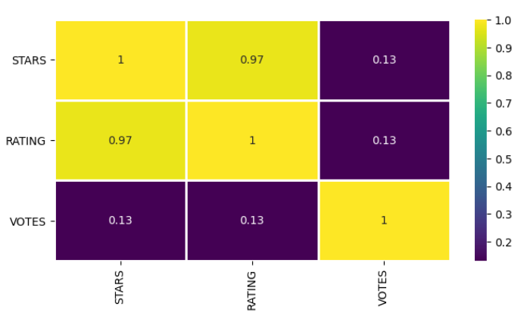
Result
The analysis will provide insights into the extent of rating disparities between Fandango and other platforms, as well as the factors contributing to these differences. Additionally, it will highlight any biases or inconsistencies in Fandango's rating system and their implications for moviegoers.

Slide 8
Conclusion
The findings of the analysis will help in understanding the reliability and accuracy of Fandango's movie ratings and guide efforts to improve transparency and credibility in the movie rating ecosystem. Addressing discrepancies and biases in Fandango's rating system can lead to better-informed decisions for movie enthusiasts and contribute to a more trustworthy movie rating landscape.

Slide 9
Future scope
Extend the analysis to include more movie rating platforms and explore trends over time.
Implement machine learning models to predict audience preferences and improve rating accuracy.
Collaborate with industry stakeholders to establish standardized rating metrics and practices for greater consistency and transparency.

Slide 10
References
Fandango. (https://www.fandango.com/)
Rotten Tomatoes. (https://www.rottentomatoes.com/)

Slide 11
THANK YOU

